Slide 1
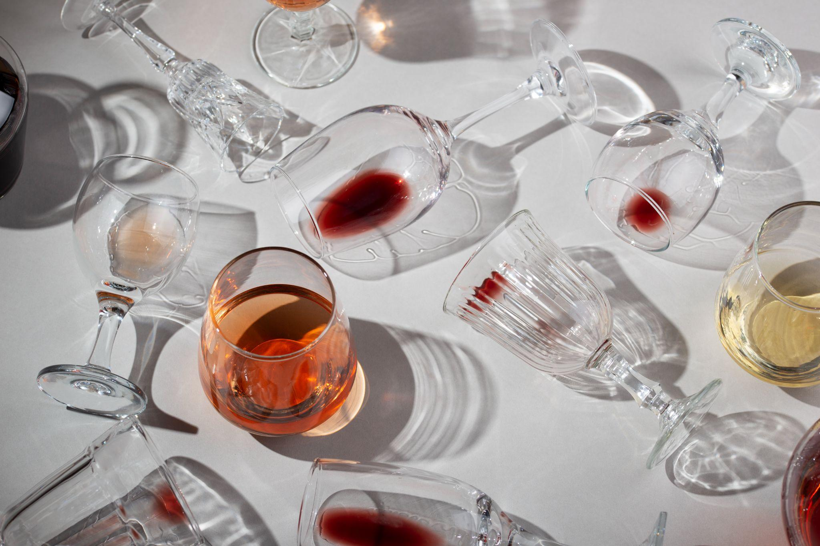
Alcohol consumption 2010-2015
Data Analytics Bootcamp

Slide 2
Table of contents
01
02
03
04
05
Project 1
Amount of alcohol consumed by gender
Most consumed type of alcohol by region
Amount of alcohol consumed by region
Amount of alcohol consumed by country

Slide 3
01
Project 1

Slide 4
Alcohol consumption
Carrying out an analysis on alcohol consumption is of the utmost importance due to the implications it has on public health and the well-being of people. Alcohol is a psychoactive substance that can negatively affect the physical, mental and social functioning of those who consume it. Understanding consumer trends is essential to inform health policies, prevention programs and promotion of healthy lifestyles.

Slide 5


As a result of a search on sites where databases are collected, we obtained the csv of that we use for the analysis below

Slide 6
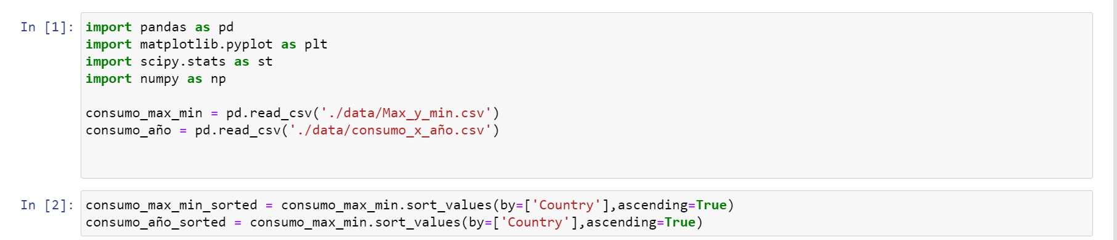
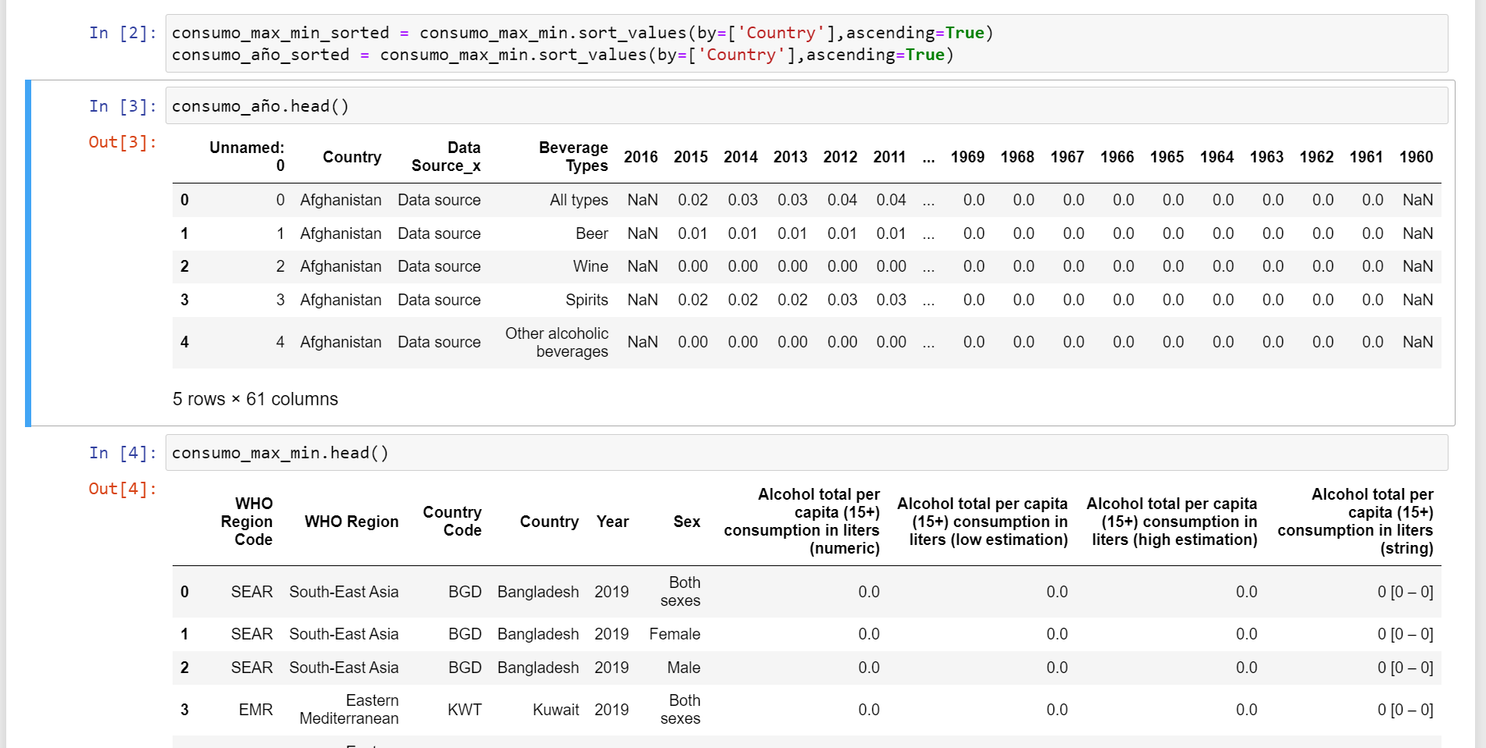

Slide 7
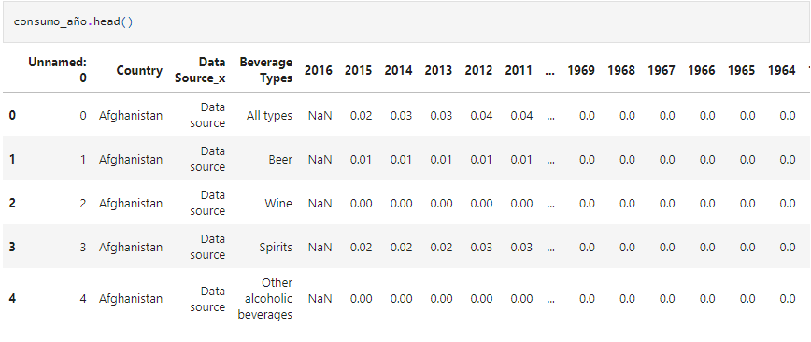
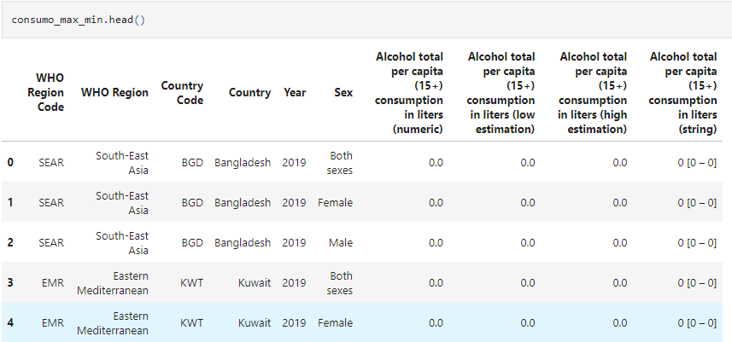
Original data before the clean up process

Slide 8
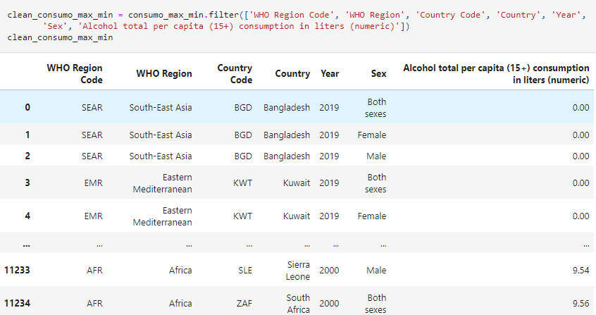
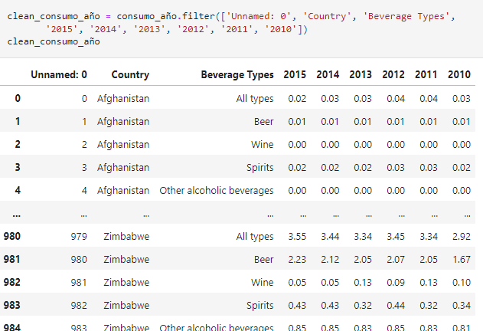
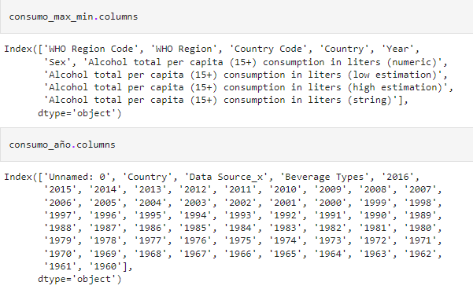
Clean up process

Slide 9
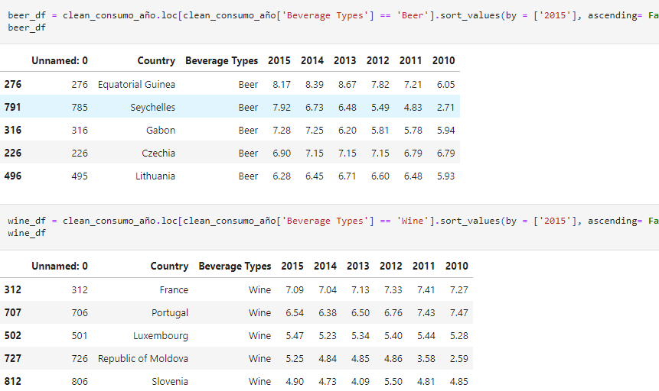
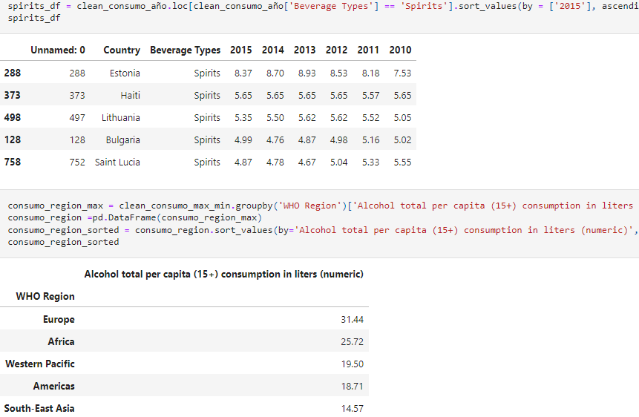

Slide 10
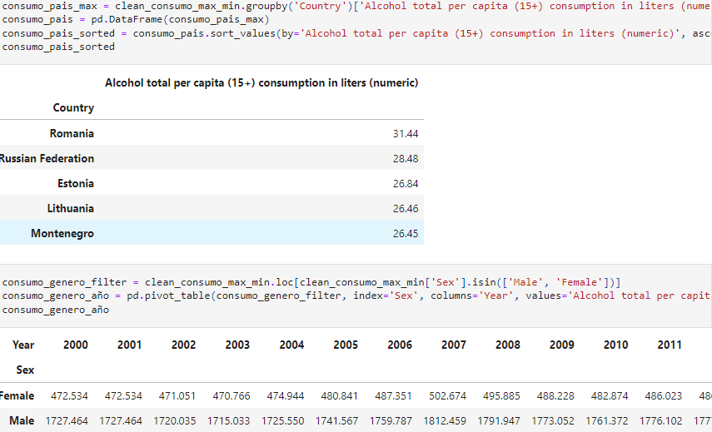
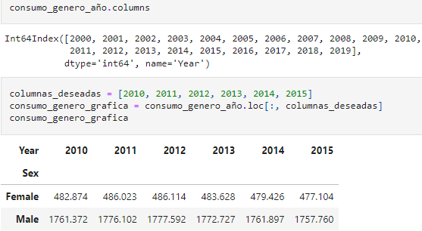

Slide 11
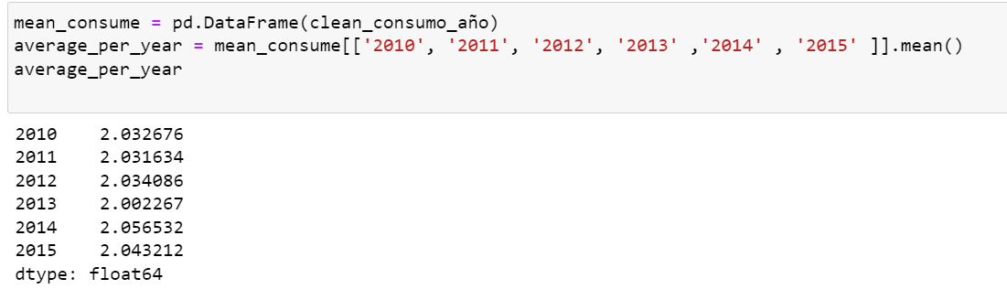
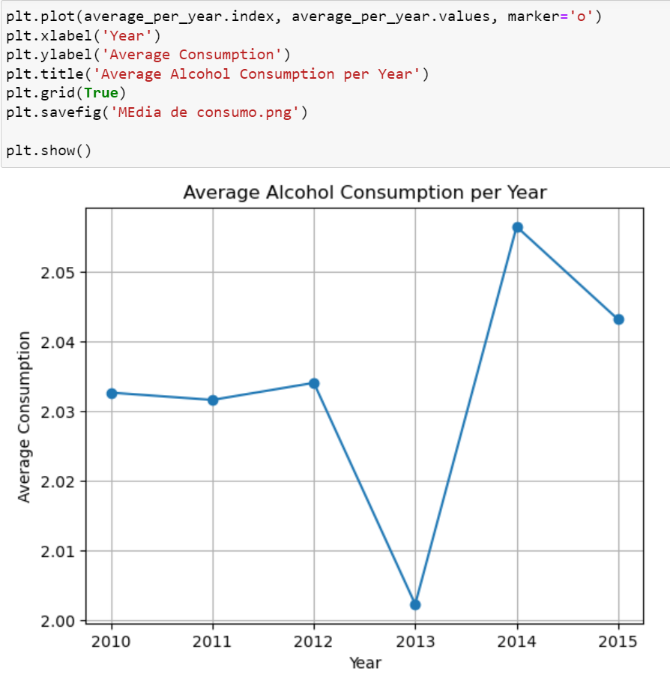

Slide 12

02
Amount of alcohol consumed
By gender

Slide 13
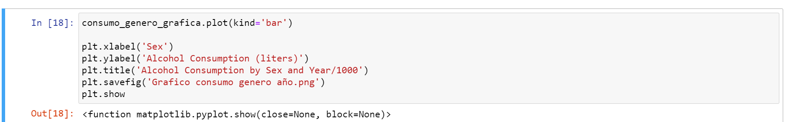
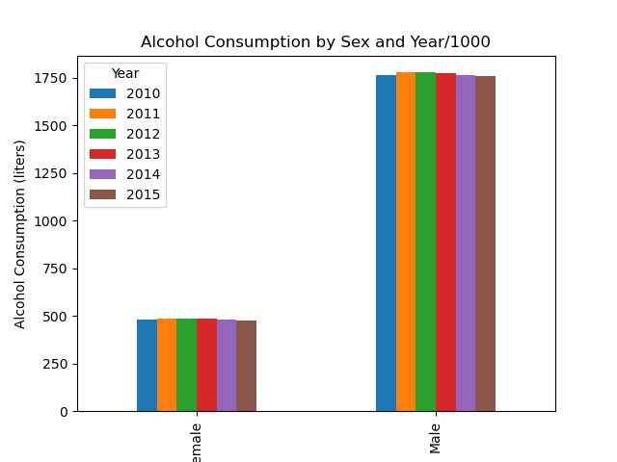

Slide 14
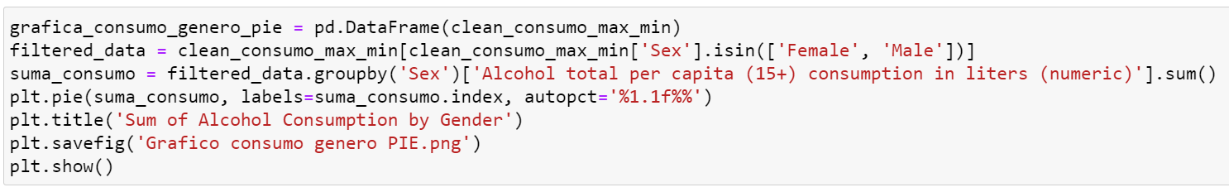
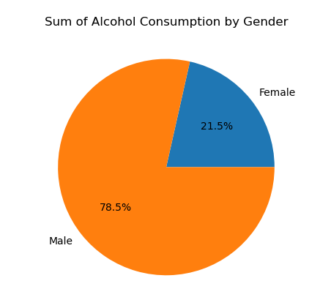
The annual alcohol consumption by sex goes around the 500 ml in females to an estimated 1.7 liters in males. The total alcohol consumers are mostly made up of the male population by being almost the 80% of the consumers.

Slide 15
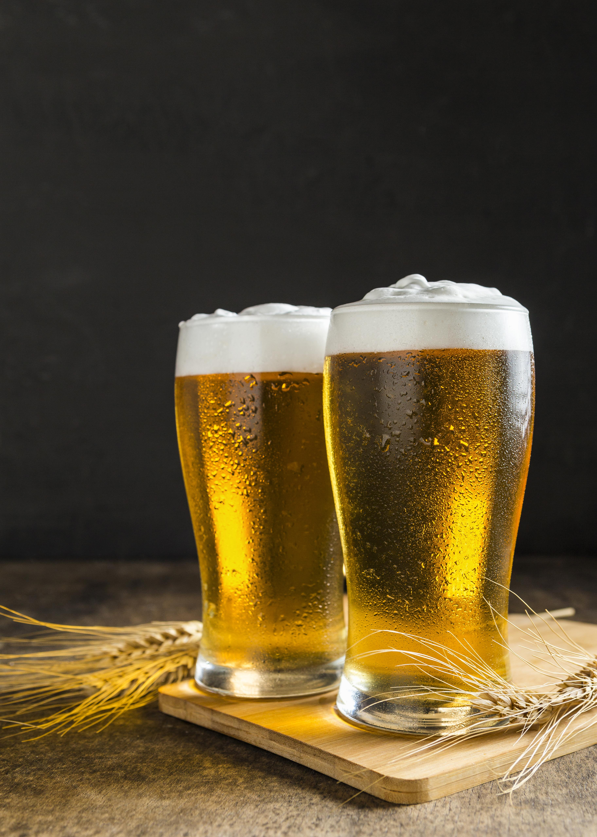
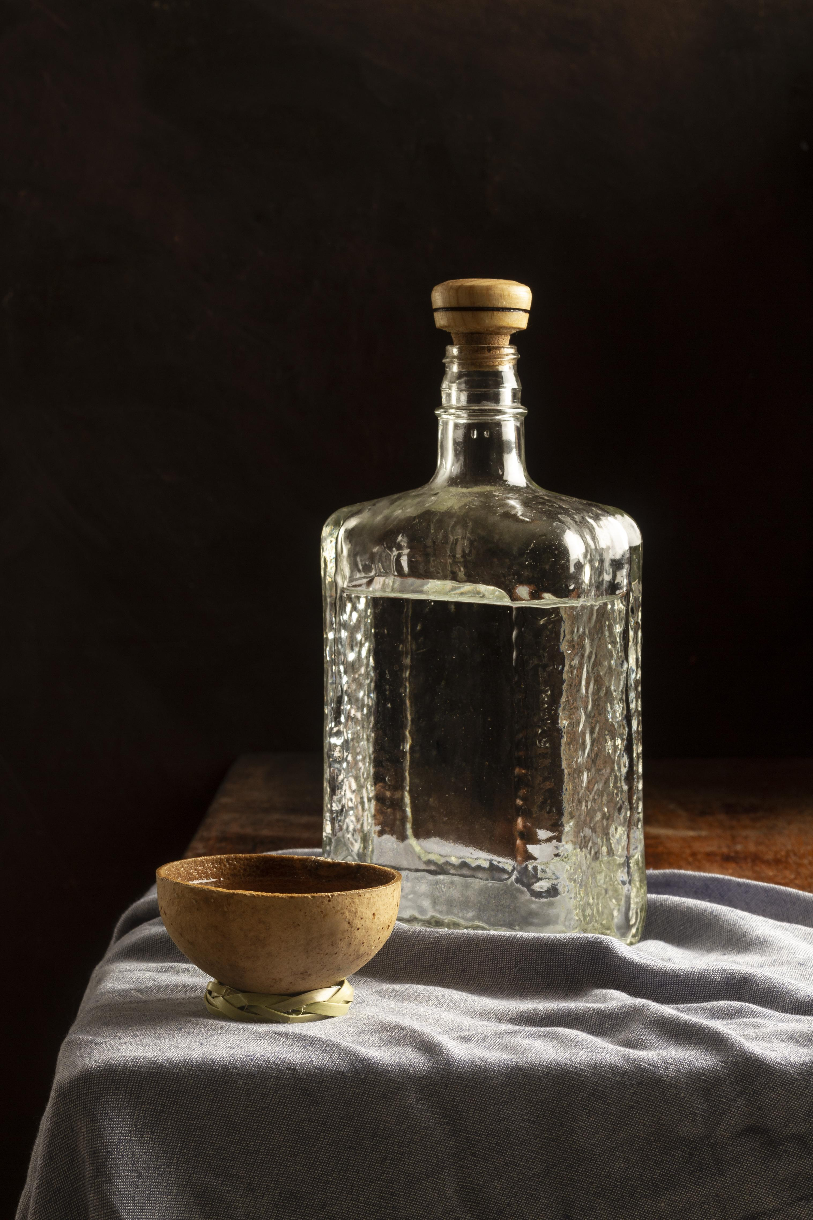
03
Most consummed type of alcohol
By region

Slide 16
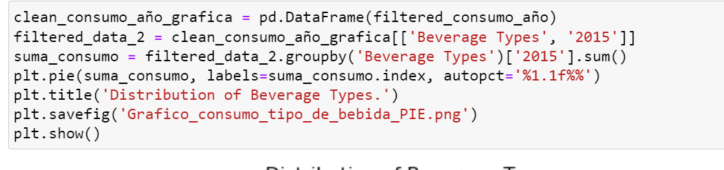
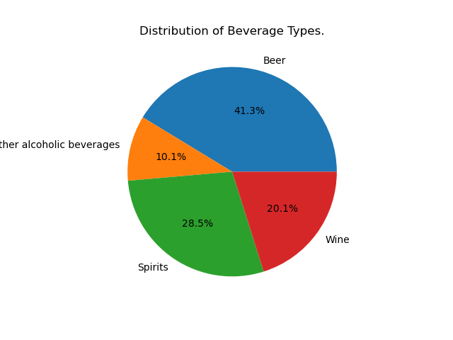

Slide 17
The distribution on what type of alcohol beverages are consumed. It shows that most of the population of consumers preferred beer as their type of drink by being 41.3% taking almost double of the total sum.

Slide 18

04
Amount of alcohol consumed
By region

Slide 19
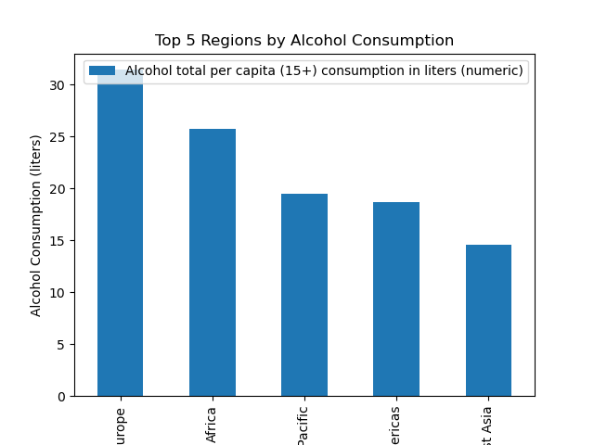

Slide 20
The amount of alcohol that is consumed in the regions that have a highest consumption goes from around the 15 liters for South – east Asia to an estimated 30 liters in Europe almost the double amount of South – east Asia.

Slide 21

05
Amount of alcohol consumed
By country

Slide 22
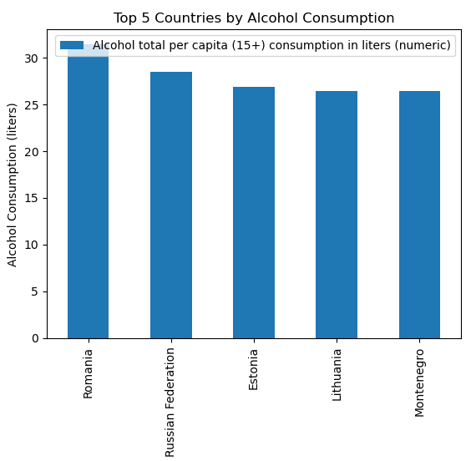

Slide 23
The amount of alcohol that is consumed in the countries that have a highest consumption goes from around the 25 liters for Montenegro to an estimated 30 liters in Romania however it does not have a distribution similar to regions graphic that had a difference of the double amount. in this graphic it only has a difference of 5 liters.

Slide 24
References
World_Alcohol_Consumption_analysis. GitHub. https://github.com/YaKsenia/world_alcohol_consumption_analysis_python/blob/master/data_world_alcohol_consumption.csv
WHO Alcohol total per capita consumption rate. (2022, 21 febrero). Kaggle. https://www.kaggle.com/datasets/mikekzan/who-alcohol-total-per-capita-consumption-rate

